Slide 1
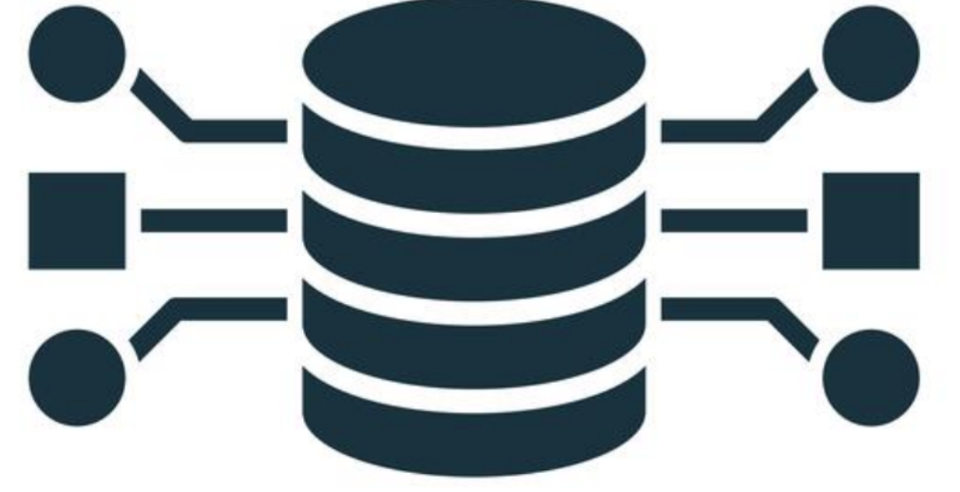
IC 217 – DATA STRUCTURES
LESSON 3:
Stack and queue

Slide 2
QUEUE DATA STRUCTURES

Slide 3
Data Structures and Algorithm
QUEUE
The word queue is British for line (the kind you wait in).
In Britain, to “queue up” means to get in line.
In computer science a queue is a data structure that is somewhat like a stack, except that in a queue the first item inserted is the first to be removed (First-In-First-Out, FIFO), while in a stack, as we’ve seen, the last item inserted is the first to be removed (LIFO).

Slide 4
Data Structures and Algorithm
QUEUE
A queue works like the line at the movies:
The first person to join the rear of the line is the first person to reach the front of the line and buy a ticket. The last person to line up is the last person to buy a ticket (or—if the show is sold out—to fail to buy a ticket).

Slide 5
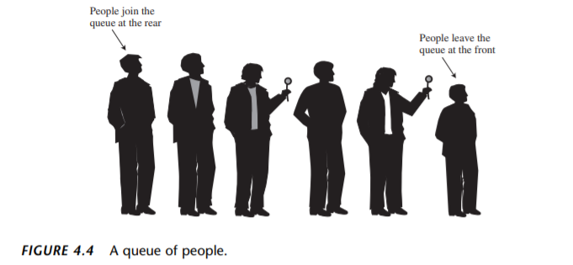
Data Structures and Algorithm
QUEUE

Slide 6
Data Structures and Algorithm
QUEUE
Data structure in which the elements are added at one end, called the rear, and deleted from the other end, called the front.
As in a stack, the middle elements of the queue are inaccessible.

Slide 7
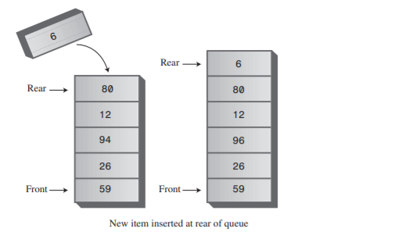
Data Structures and Algorithm
QUEUE
An insertion to a queue is done via enqueue operation,
Which always inserts the new element at the rear.

Slide 8
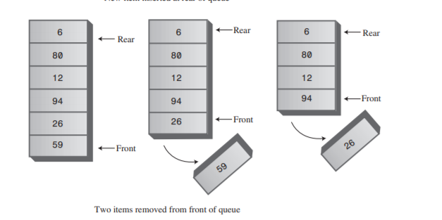
Data Structures and Algorithm
QUEUE
A deletion is done via a dequeue operation,
Which always removes the element from the front of the queue.

Slide 9
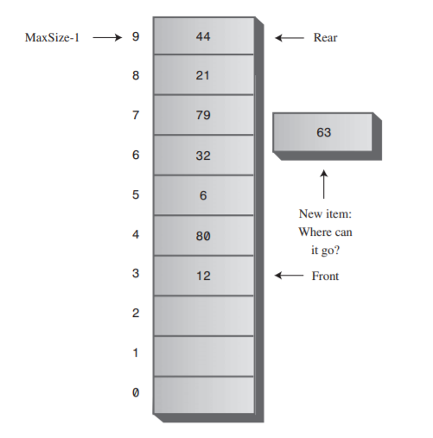
Data Structures and Algorithm
CIRCULAR QUEUE

Slide 10
Data Structures and Algorithm
CIRCULAR QUEUE
To avoid the problem of not being able to insert more items into the queue even when it’s not full, the Front and Rear arrows wrap around to the beginning of the array. The result is a circular queue (sometimes called a ring buffer).

Slide 11
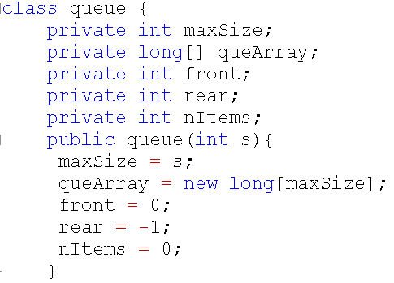
Data Structures and Algorithm
Queue Sample Program
Queue Sample Program

Slide 12
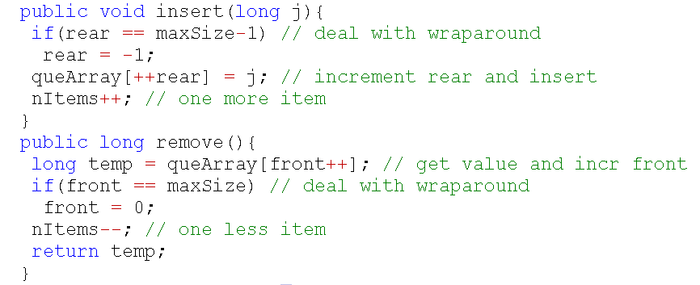
Data Structures and Algorithm
maxSize=5; front =0; rear=-1; nItems=0
Queue Sample Program
insert(10)
-1 ==4? F
queArray[0]=10 rear=0
nItems=1
insert(50)
3==4? F
queArray[4]=50 rear=4
nItems=2
insert(20)
0 ==4? F
queArray[1]=20 rear=1
nItems=2
remove()
temp=queArray[0] 10
1==5? F
nItems=3
return 10
insert(60)
4==4? T
rear=-1
queArray[0]=60 rear=0
nItems=3
insert(30)
1 ==4? F
queArray[2]=30 rear=2
nItems=3
remove()
temp=queArray[1] 20
2==5? F
nItems=2
return 20
Queue Sample Program
insert(70)
0==4? F
rear=-1
queArray[1]=70 rear=1
nItems=4
60
rear
[0]
10
front
insert(40)
2 ==4? F
queArray[3]=40 rear=3
nItems=4
[1]
20
front
70
rear
30
front
remove()
temp=queArray[2] 30
3==5? F
nItems=1
return 30
[2]
80
rear
insert(80)
1==4? F
rear=-1
queArray[2]=80 rear=2
nItems=5
[3]
40
rear
front
[4]
50
rear

Slide 13
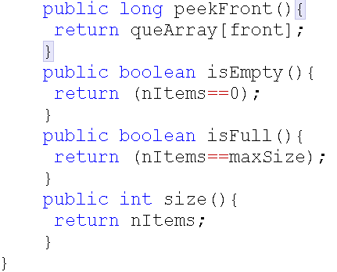
Data Structures and Algorithm
Queue Sample Program
Queue Sample Program

Slide 14
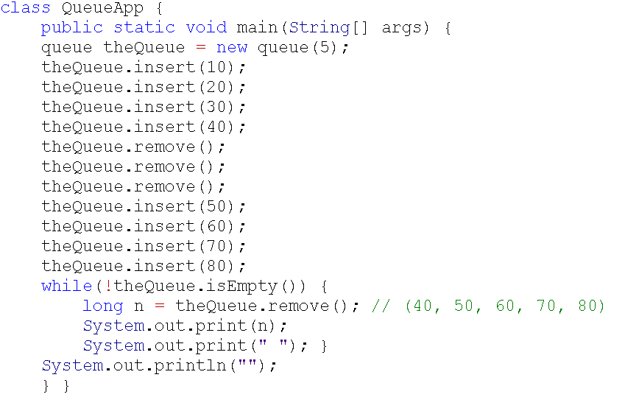

Data Structures and Algorithm
Queue Sample Program
Queue Sample Program
OUTPUT

Slide 15
Data Structures and Algorithm
PRIORITY QUEUE
Like an ordinary queue, a priority queue has a front and a rear, and items are removed from the front.
However, in a priority queue, items are ordered by key value so that the item with the lowest key (or in some implementations the highest key) is always at the front. Items are inserted in the proper position to maintain the order.

Slide 16
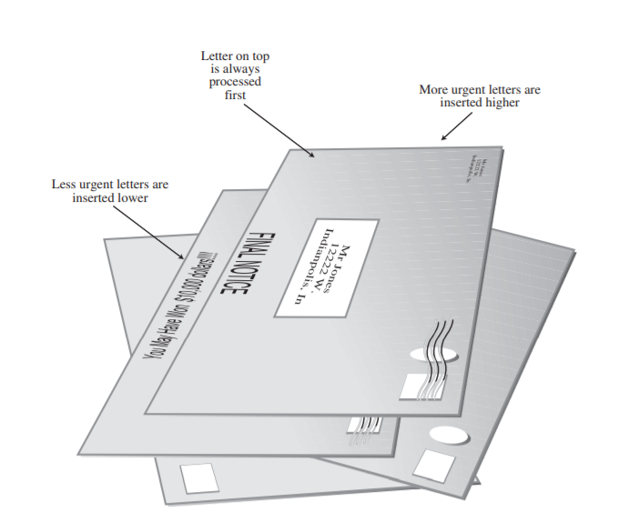
Data Structures and Algorithm
PRIORITY QUEUE

Slide 17
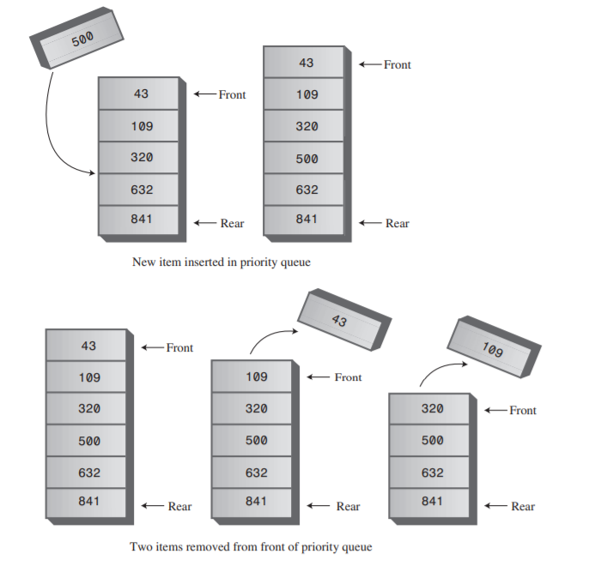
Data Structures and Algorithm
PRIORITY QUEUE

Slide 18
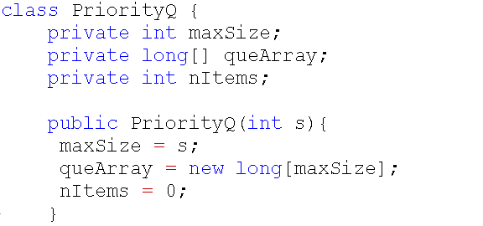
Data Structures and Algorithm
Priority Queue Sample Program
Queue Sample Program

Slide 19
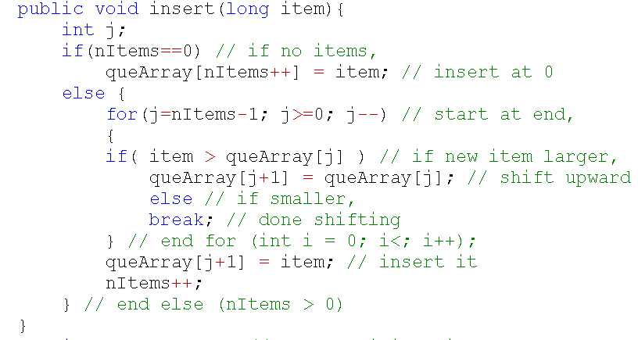
Data Structures and Algorithm
maxSize=5; nItems=0
Priority Queue Sample Program
insert(30)
item=30
0==0? T
queArray[0] = 30
nItems=1
insert(20)
item=20
4==0? F
j=3 3>=0? T
20 > 10? T
queArray[4] = queArray[3]
= 10
insert(40)
item=40
3==0? F
j=2 2>=0? T
40 > 10? T
queArray[3] = queArray[2]
= 10
insert(50)
item=50
1==0? F
j=0 1>=0? T
50 > 30? T
queArray[1] = queArray[0]
= 30
j=2 2>=0? T
20 > 30? F
break for
queArray[3]=20
nItems=5
j=1 1>=0? T
40 > 30? T
queArray[2]=queArray[1]
=30
Queue Sample Program
j=0 0>=0? T
40 > 50? F
break for
queArray[1]=40
nItems=4
j=-1 -1>=0? F
queArray[0] = 50
nItems=2
[0]
30
50
insert(10)
item=10
2==0? F
j=1 1>=0? T
10 > 30? F
break for
queArray[2] = 10
nItems=3
40
[1]
30
30
[2]
10
20
[3]
10
[4]
10

Slide 20
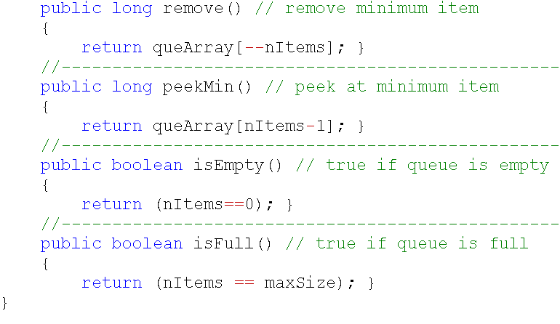
Data Structures and Algorithm
Priority Queue Sample Program
Queue Sample Program

Slide 21
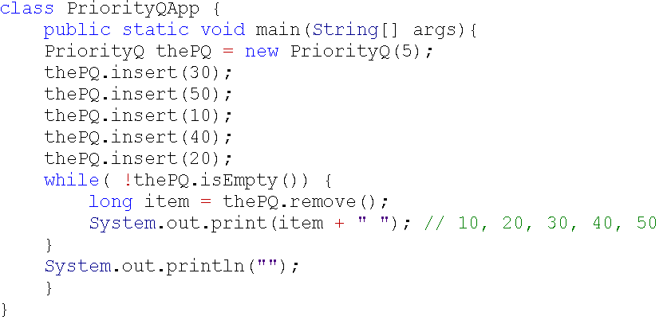
Data Structures and Algorithm
Priority Queue Sample Program
Queue Sample Program
OUTPUT

Slide 22
QUESTIONS?
LESSON 3:
Stack and queue

